Slide 1

Senior Design Project Car Care
Dilara YALÇIN – 130709018
Muğla Sıtkı Koçman University
Computer Engineering Department
Advisor; Tuğba SÜZEK, PhD

Slide 2

Goal
Create a simple and functional mobile application letting users follow car related chores

Slide 3
Motivations
Observation of an elderly relative who keeps track of his car’s fuel consumption for years in a hand written diary
Following the car related deadlines (taxes, regular maintenance dates such as oil change) is crucial for a healthy car ownership
Families with multiple cars and busy schedules
Car rental agencies who operate multiple cars might need a system to track each car’s operational details

Slide 4
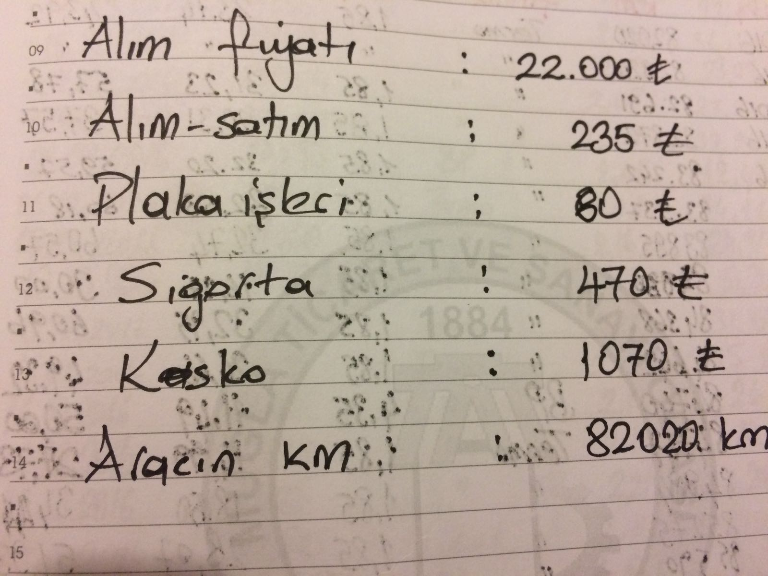
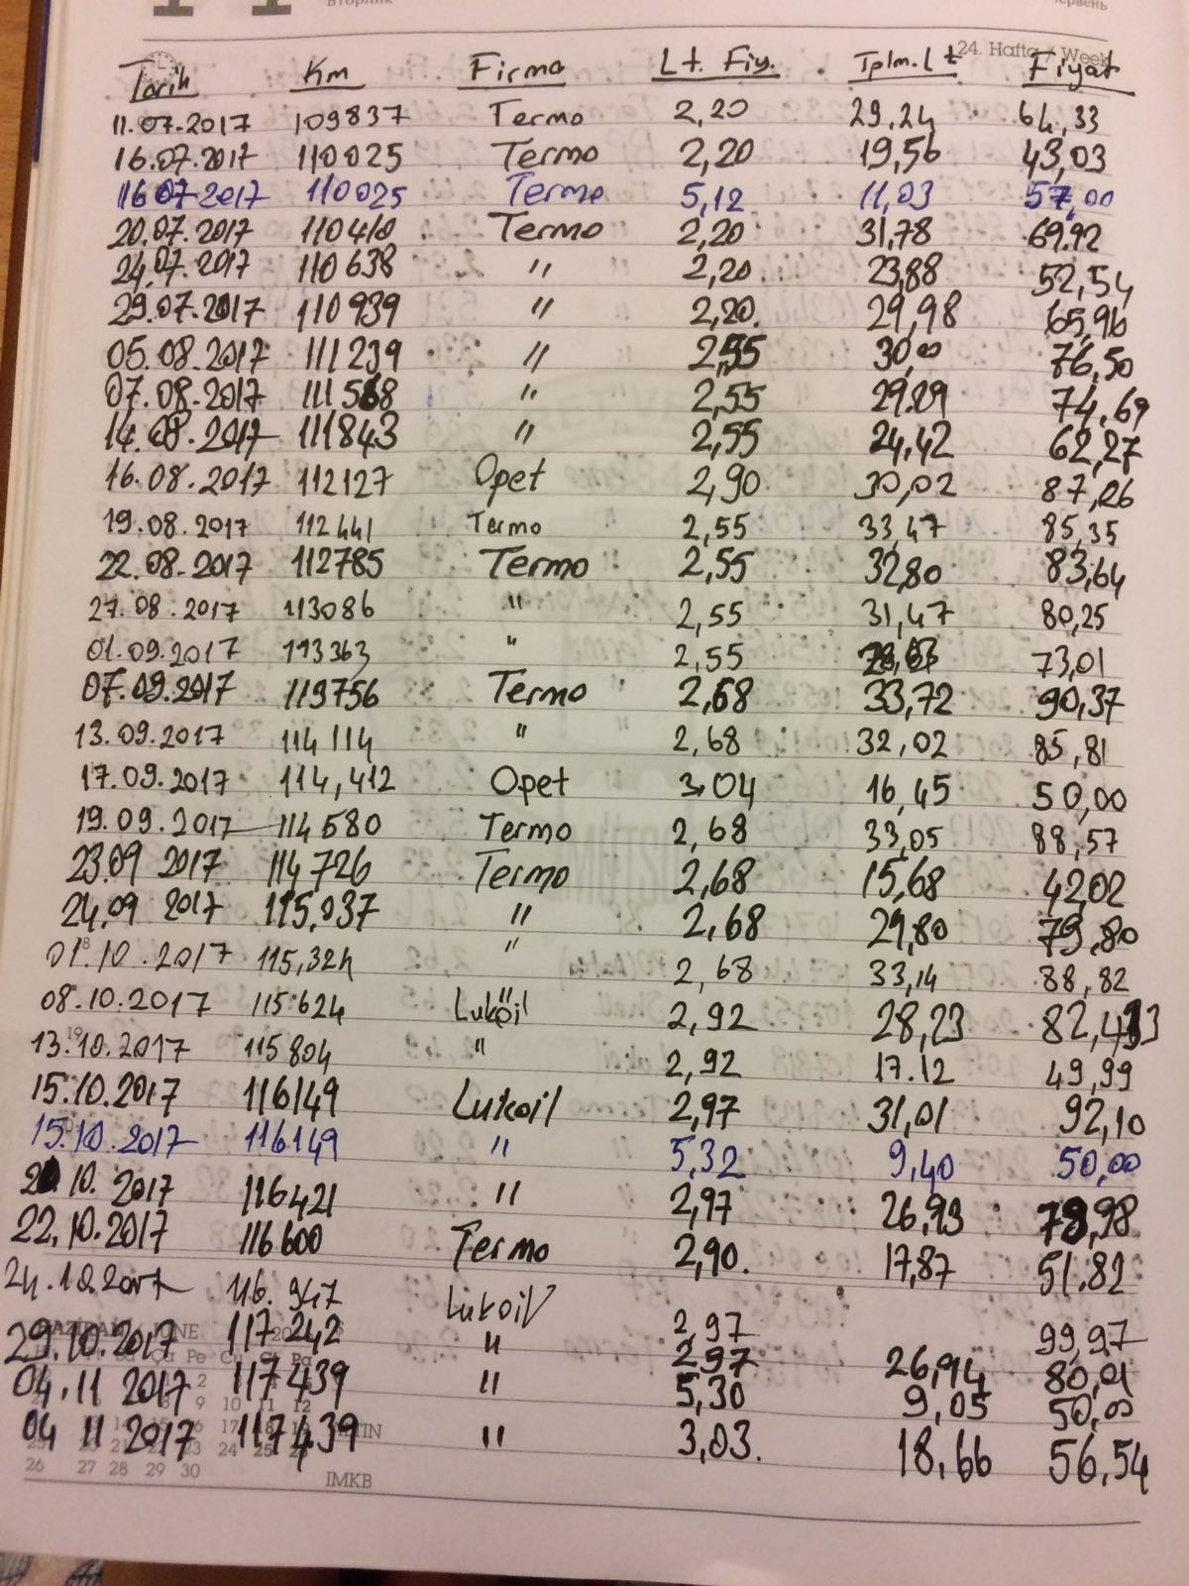

Slide 5


Market Analysis
Diversity: There is connection between application and car. When there is a problem on the car, the app will run.
Similarity: Use the car's features.
Diversity: It is a paid application and available in different languages.
Similarity: There is a note section.

Slide 6
Differences
Language of my project will be Turkish
Connection to e-devlet web site
Access to the fuel statistics of cars

Slide 7
Benefits of Project
With this application, car owners can follow the car related chores following the mobile applications
History of all car maintenance details can be stored
Sample use-cases:
Upcoming visa date
Traffic ticket payment history

Slide 8








Tools
DB Management Tool: phpMyAdmin
(on web host)
Mobile Operating System: Android
IDE: Android Studio
Additional Language: PHP
Build System: Gradle
Web Host Website:
http://000webhost.com
Database: MySQL
REST API: Volley

Slide 9
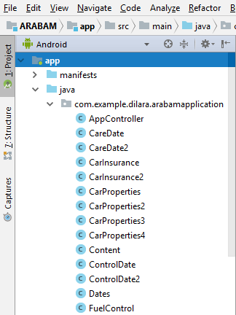
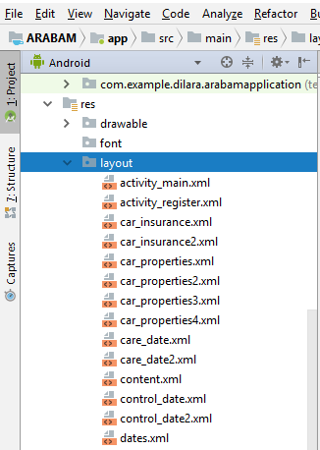
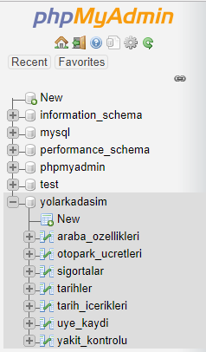
Database and Project Structure
Database
Project Structure

Slide 10
Roadmap of Database Operations
Open Web Host
Create Database
Create Database Table
Upload the PHP Files to Web Host
Write Android Codes
View the simulator

Slide 11
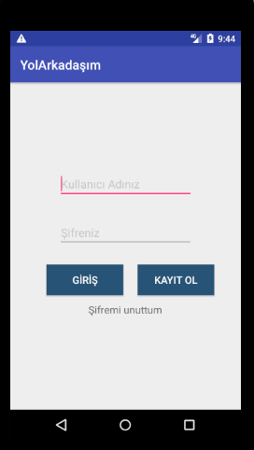
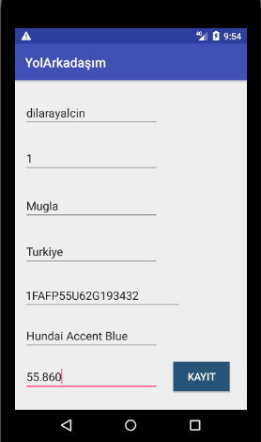
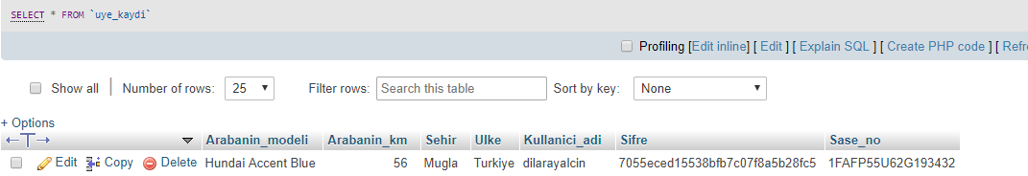

Slide 12

For Listening!

